Slide 1



Bash Commands in Linux
Welcome to the world of Linux command line! Explore the power and versatility of bash commands in this comprehensive presentation.
SB
by Snigdha Bobbili

Slide 2
Navigation Made Easy
Change Directory
List Contents
Navigate seamlessly through the file system using the cd command and its various options.
Display files and directories with ls, and unleash its potential with options like -l and -a.
Go Back and Forth
Home Sweet Home
Use the "cd -" command to quickly switch between your current and previous working directories.
Return to your home directory effortlessly with the "cd ~" command.

Slide 3
Creating and Modifying
1
Create Files and Directories
Use touch and mkdir commands to create new files and directories with ease.
Update and Modify
2
Edit file content with a powerful text editor like Vim, and learn the different modes and commands.
3
Delete with Caution
Remove files and directories securely with rm and rmdir, and learn to use the appropriate options to avoid accidental deletion.

Slide 4

Search and Filter Like a Pro
1
Find Files
2
Search within Files
Locate files based on various criteria using the find command and its options.
Filter text data using powerful search tools like grep, tail, and head.
3
Pipe and Redirect
Combine commands using | (pipe) and > (redirect) to process and manipulate data efficiently.

Slide 5
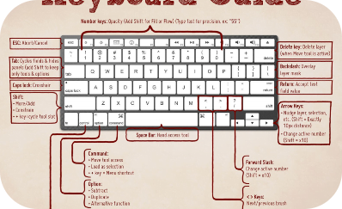
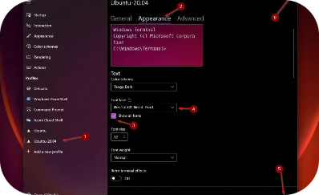

Efficiency at Your Fingertips
Command History and Shortcuts
Customize Your Bash
Scripting Superpowers
Personalize your command line experience by creating aliases and setting environment variables.
Discover the world of bash scripting and automate repetitive tasks with loops, conditionals, variables, and functions.
Master the art of using history commands, keyboard shortcuts, and tab completion to boost your productivity.

Slide 6
Unleash the Power
Command Substitution
File Permissions
Embed command output within other commands to achieve powerful and dynamic effects.
Understand and manage file permissions using chmod and chown commands for enhanced security.
Process Monitoring
Networking and Security
Monitor and manage running processes using top, ps, and kill commands to optimize system performance.
Explore networking commands like ping and ssh, and learn how to secure your system with firewall configuration.

Slide 7
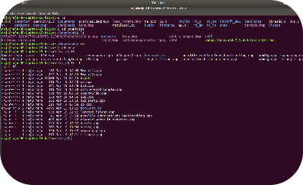


Become a Bash Guru
Advanced Commands
Master the Keyboard
Embrace the Open Source
Unlock the potential of lesser-known yet powerful commands to become a true command line pro.
Optimize your efficiency by mastering keyboard-based navigation and text editing techniques.
Embody the spirit of Linux and contribute to the vibrant community by sharing your knowledge.

Slide 8

Wrap-up
Review the key concepts and commands covered in this presentation.
Continue your journey by exploring advanced topics and experimenting with more complex scenarios.
Unlock the full potential of your Linux system with the command line!

